Slide 1
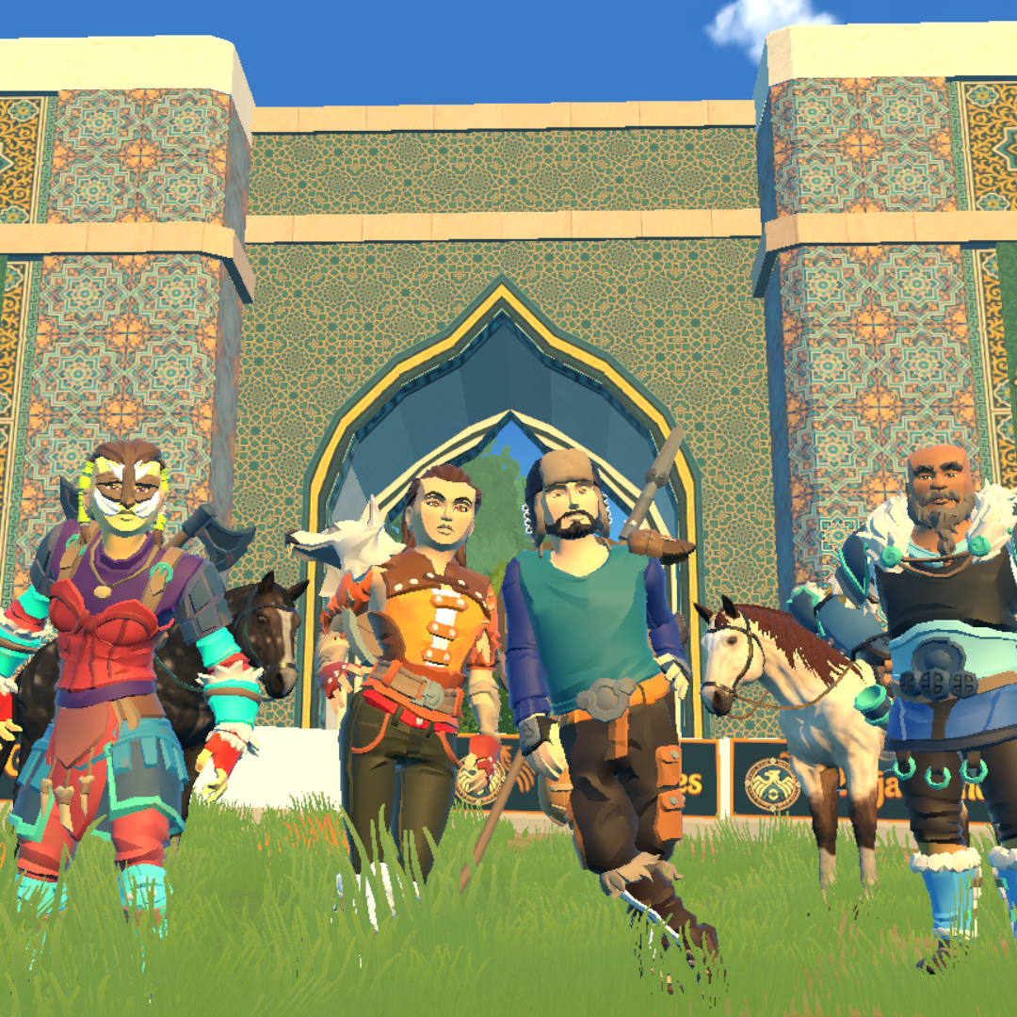

NOMAD RIVALS
KOPKARI ON MOBILE
Traditional horse sport.
Global competition.
KAJA GAMES / PITCH 2026

Slide 2
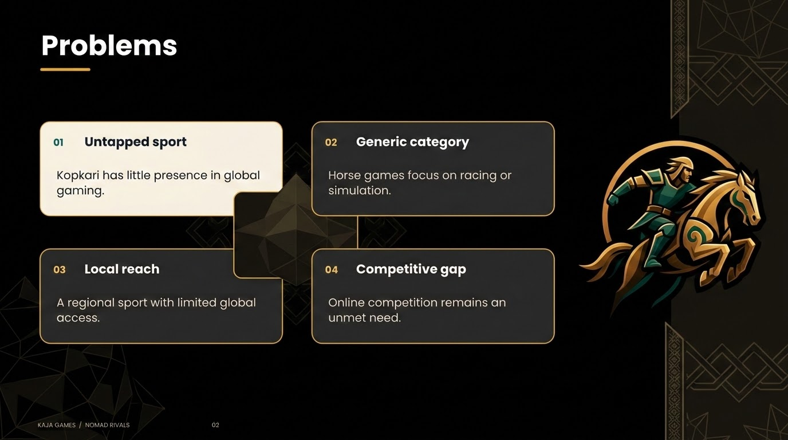

Slide 3
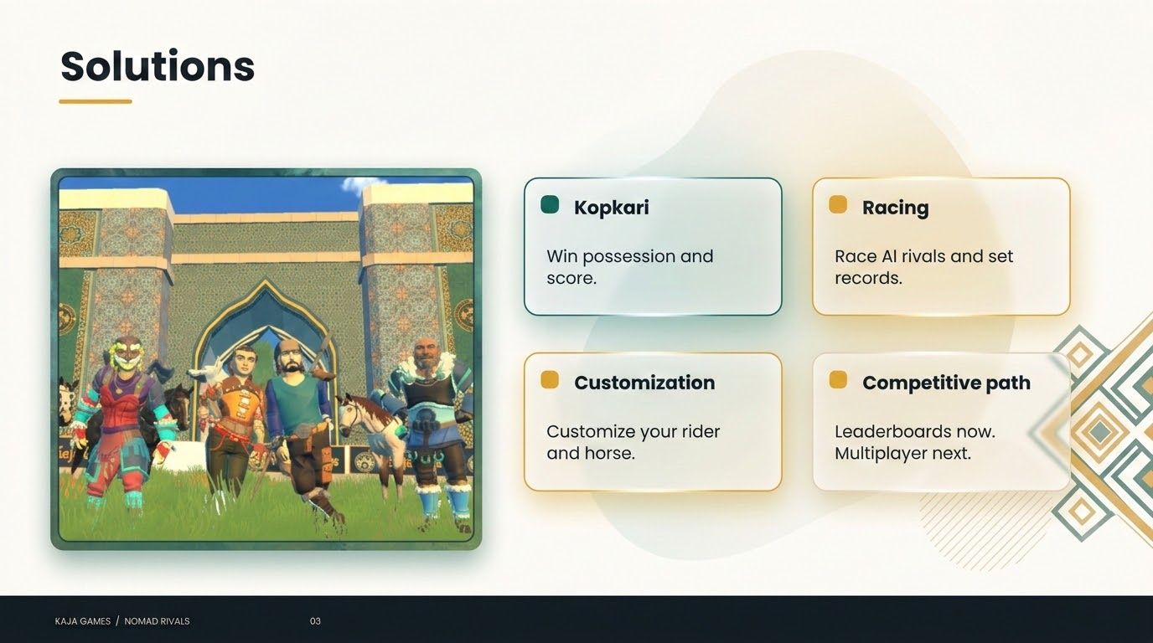

Slide 4
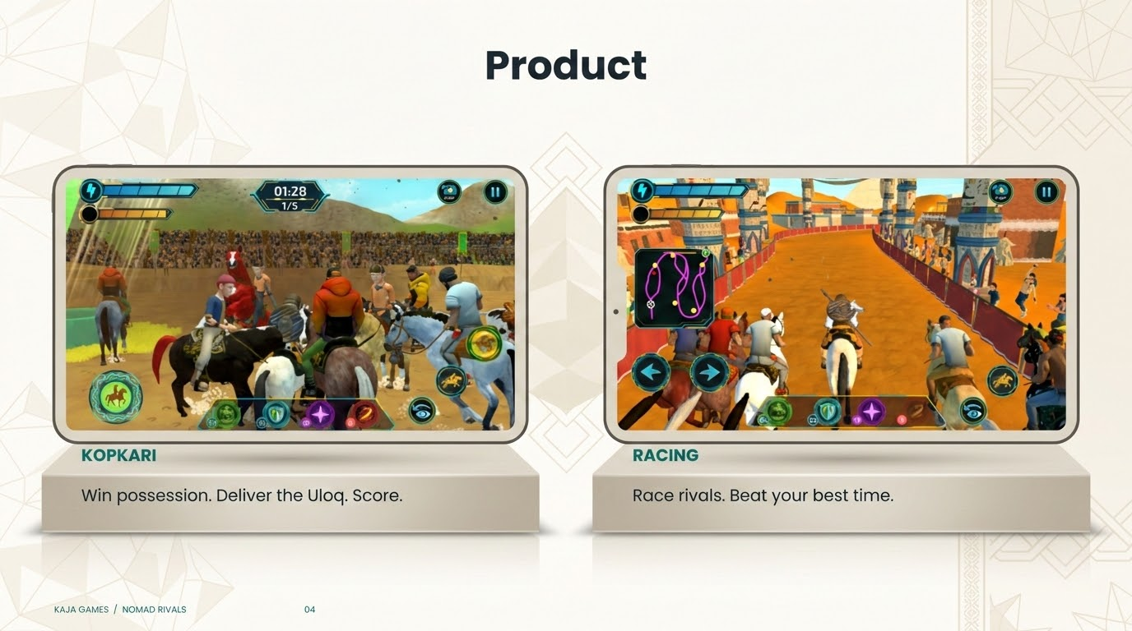

Slide 5
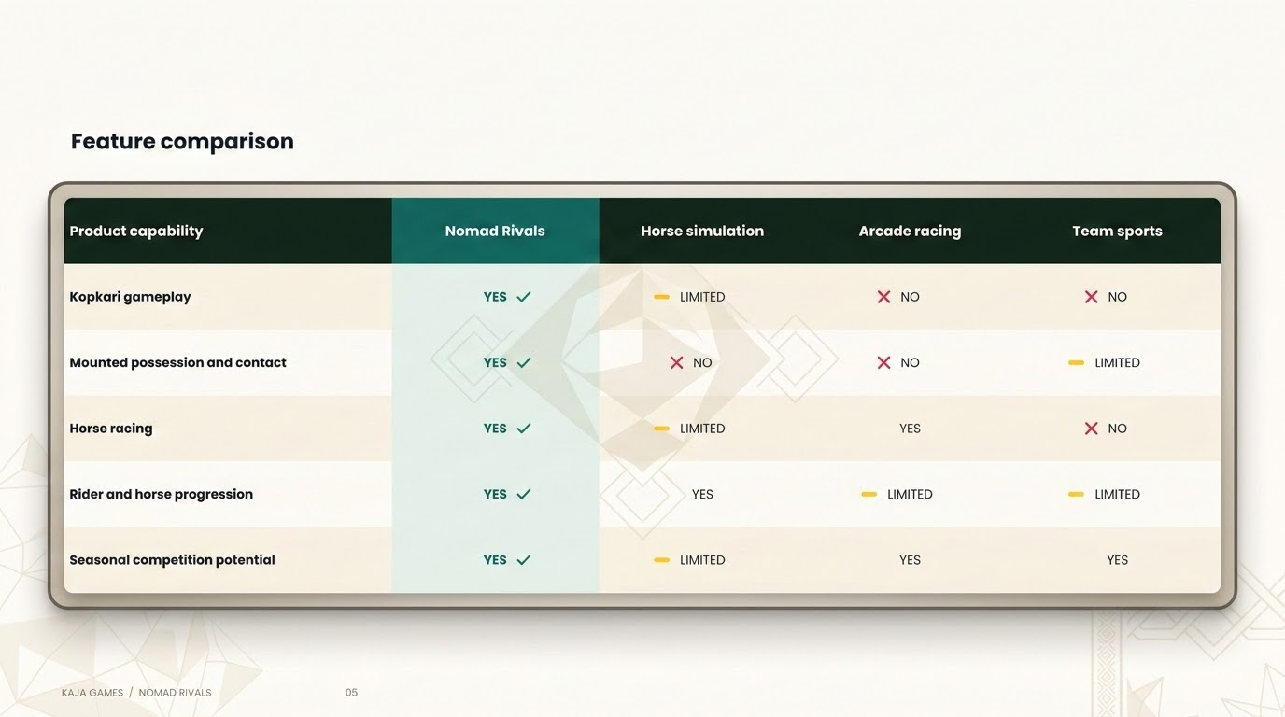

Slide 6
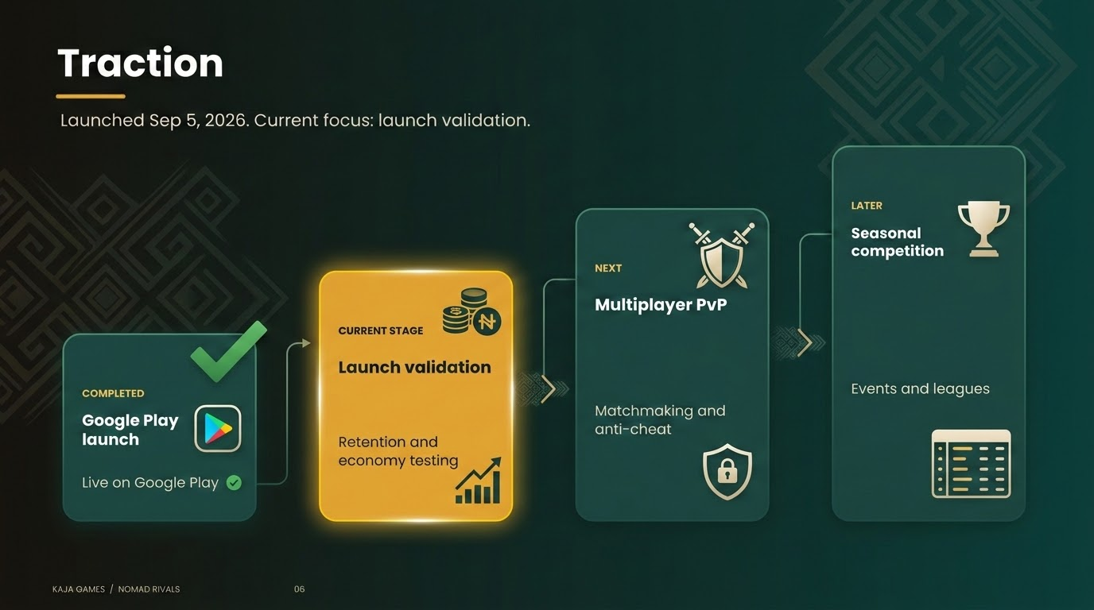

Slide 7
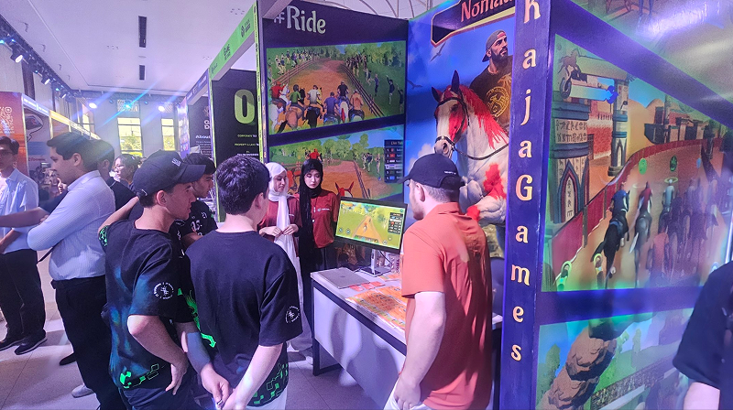
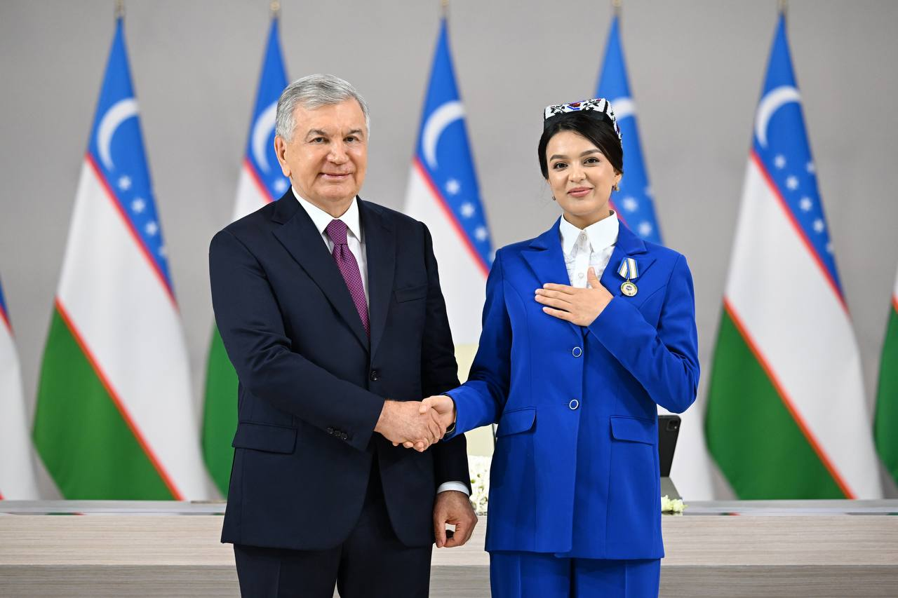
Traction
Google Play launch: Sep 5, 2026
31.4K
4.87K
2.97K
Device impressions
Device acquisitions
Monthly active devices
Google Play Console reporting window: Aug 19–Sep 15, 2026
PUBLIC VALIDATION
Game Fest 2025 and 2026
ICT Week 2025
National recognition
Presidential recognition, 2026
Plug and Play / IT Park
KAJA GAMES / NOMAD RIVALS 07

Slide 8
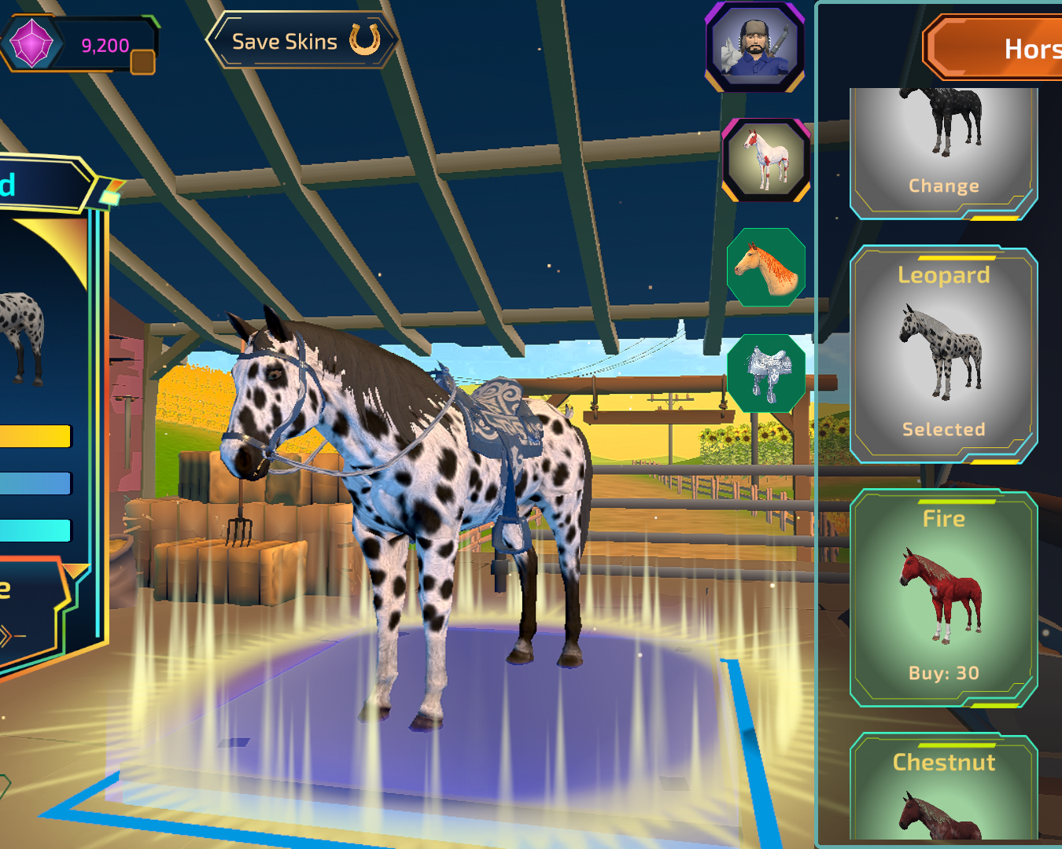
Business Model
Customization
Rider and horse cosmetics
In-game store
Coins, Nyufiy and gameplay bundles
Advertising
Rewarded and interstitial ads
B2B services
Branded in-game placements
KAJA GAMES / NOMAD RIVALS 08

Slide 9
1st Revenue Stream
2nd Revenue Stream
In-app purchases
Advertising
Gameplay bundles
Rewarded ads
Coins + gameplay items + skins
Optional ads for in-game rewards
Nyufiy currency packs
Currency packs with bonuses
Interstitial ads
Ads with controlled frequency
Bonus Card
Nyufiy + Defense items
KAJA GAMES / NOMAD RIVALS 09

Slide 10
Packages and Pricing
One-time purchases
Gameplay bundles
Nyufiy currency packs
Nomadic Starter
$10.96
Nyufiy | Bonus | Approx. USD
4,200 | + 150 | $3.43
7,500 | + 250 | $5.77
21,500 | + 2,100 | $17.54
35,000 | + 3,500 | $28.50
63,000 | + 5,000 | $47.50
99 Coins + Slow Trap ×3 + Defense ×3
Nomadic Explorer
$16.81
149 Coins + Defense ×4 + Web Snare ×4
Nomadic Warrior
$22.65
199 Coins + Decoy ×5 + Defense ×5
Bonus Card $6.94
7,900 Nyufiy + Defense ×10
USD estimates, not US store prices. $1 = KRW 1,368.56 (Sep 16, 2026).
KAJA GAMES / NOMAD RIVALS 10

Slide 11
Market Size
$103B
Mobile games, 2025
55% of global revenue
$188.8B
GLOBAL GAMES
+7%
MENA game installs
2024 annual growth
ANDROID FIRST
Launch platform
Sources: Newzoo (2025), Adjust (2025), as cited in original pitch
KAJA GAMES / NOMAD RIVALS 11

Slide 12


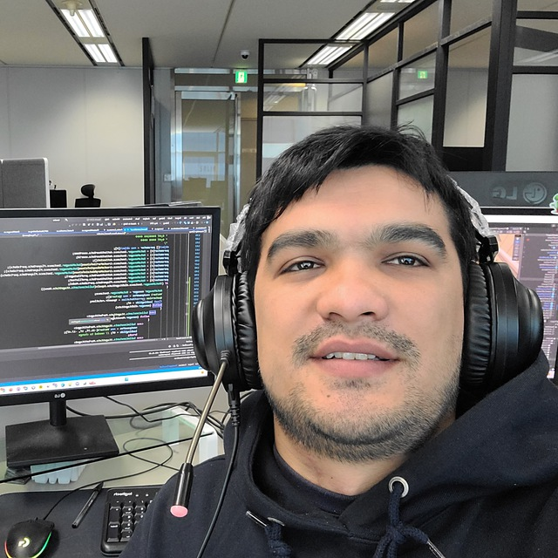


Meet the team
Nurmamatova Pokiza
Malikova Ozoda
Nurmamatov Dilshod
Abdullayev Abdumalik
Abdurazzakov Ravshan
CEO & Art Director
3D Artist
Game Developer
Product Manager
Marketing
5+ years leadership
6+ years 3D design
7+ years Game Development
Unity development
4+ years targeting
$125K RAISE PLANNING / kaja-games.com / business@kaja-games.com
KAJA GAMES / NOMAD RIVALS 12

